Slide 1
Digital mHealth to Support Individualized and Differentiated HIV Care Models
Jamie Forrest, PhD(c)
School of Population and Public Health
University of British Columbia
jforrest@mteksciences.com

Slide 2
I have no conflicts of interest to declare.

Slide 3
Differentiate Care for HIV
Differentiated care is a client-centred approach that simplifies and adapts HIV services across the cascade to reflect the preferences and expectations of various groups of people living with HIV (PLHIV) while reducing unnecessary burdens on the health system. By providing differentiated care, also called differentiated service delivery, the health system can reallocate resources to those most in need.

Slide 4
WelTel: weekly two-way SMS checkins
www.weltel.org

Slide 5
Detecting ‘stability’ – Differentiated Care
Time Frame ~1 year
Detection Methods
Early detection Late detection
Real-time Self-report
Dose monitors (EDM)
Clinic self-report / pill counts
Lab markers
(VL, CD4)
Clinical failure (AIDS, OI, death)
Stability
Stable Unstable
Clinic Visit
Clinic Visit
Clinic Visit
(~2x per year)
WelTel Check-in
As needed (patient-centered)
Individualized (differentiated) care paths

Slide 6
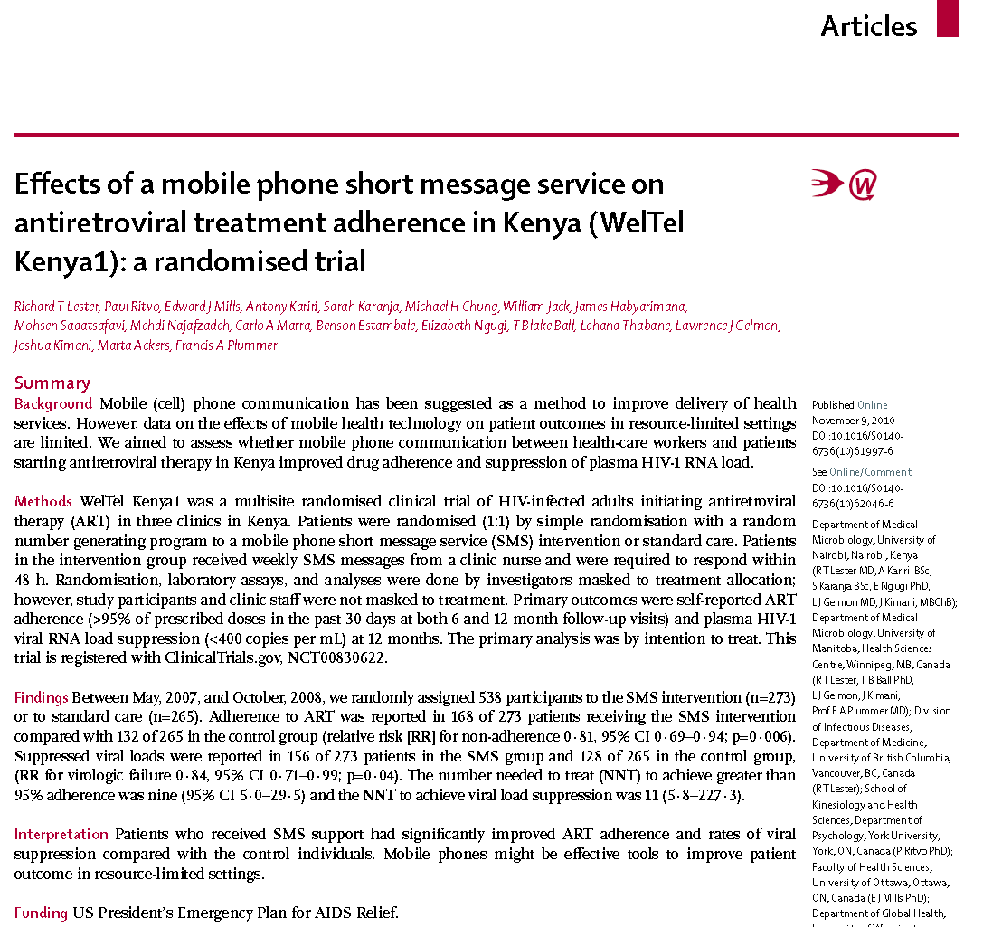
WelTel HIV: Improved Adherence and HIV viral suppression
2010
2018

Slide 7
Methods
Secondary analyses of data collected on participants allocated to the intervention arms of the WelTel Retain (NIH#R01MH097558-01) and the WelTel Kenya1 (PEPFAR PHE:KE07.0045) trials.
We derived three 12-month outcome variables to define patient stability:
two or more clinical visits at least six months apart and,
viral suppression.
We assessed response rates to weekly SMS check-ins over 52 weeks, comparing stably and unstably categorized participants using the Mann-Whitney U-test and linear regression of response rates over time.

Slide 8
Results: Viral Suppression
Figure. WelTel Kenya1 SMS response rates (n=16,754 messages sent to n=349 users between Apr 2013 and Jun 2016) stratified by clinical stability. Density plot of response rates after 52 weeks [Panel A]; mean response rates by post-enrolment week [Panel B].

Slide 9
Results: Retention in care (clinic visits)
Figure. WelTel Retain SMS response rates (n=16,754 messages sent to n=349 users between Apr 2013 and Jun 2016) stratified by clinical stability. Density plot of response rates after 52 weeks [Panel A]; mean response rates by post-enrolment week [Panel B].

Slide 10
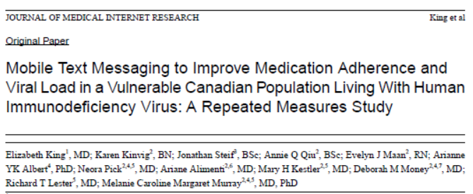
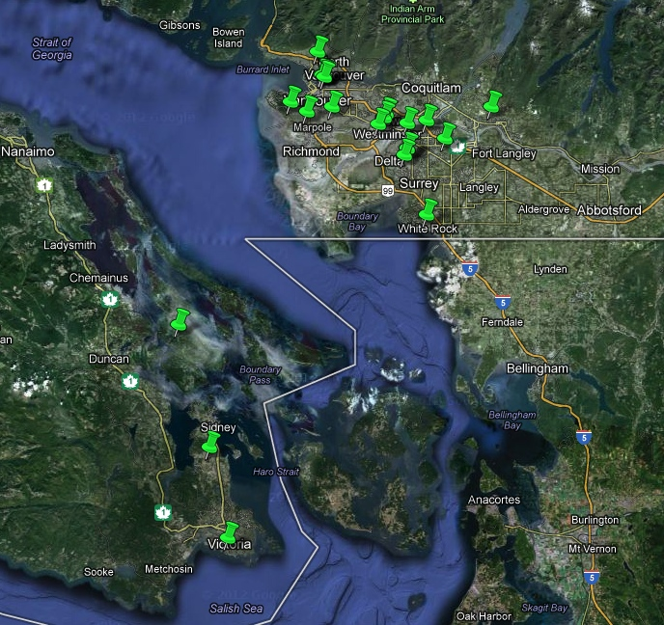
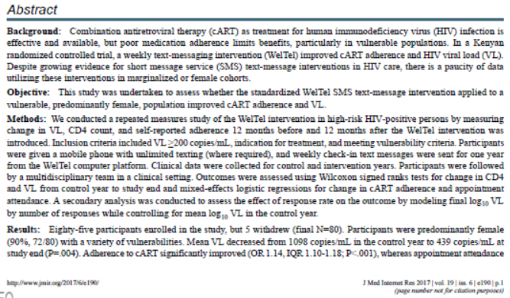
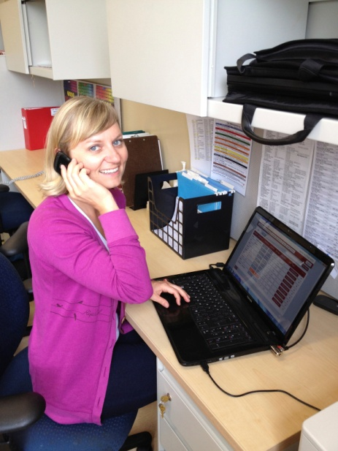
Note: Improved viral suppression in Canada
2017
Vancouver, BC

Slide 11
Bottom line
Differentiated service models may improve quality and efficiency of care
Clinical indicators of patient stability indicate starting to fail, ‘too late’
Digital/mobile health can improve adherence, viral suppression, and quality of life (GRADE A evidence)
Digital/mobile phone support can differentiate patient stability, before clinical indicators and may enhance quality and efficiency of HIV care

Slide 12
Acknowledgements
Matthew Budd
Cheng (Kim) Li
WelTel Kenya1 study team
Umanitoba, UNairobi,
WelTel Retain study team
UBC, Amref, Unairobi
Dr. Sabin Nsanzimana (Rwanda)
Dr. Meshack Ndirangu (Amref)
Richard.lester@ubc.ca
rich@weltel.org
www.weltel.org

